Slide 1


Predicting Mortality in the CRRT Population
Christopher V. Cosgriff, David Sasson, Colby Wilkinson, Kanhua Yin

Slide 2
Background: CRRT
Continuous renal replacement therapy (CRRT), including hemofiltration, hemodialysis, and hemodiafiltration, is a renal replacement strategy that commonly required in ICU patients with acute kidney injury (AKI)
Both AKI and CRRT are associated with high in-hospital mortality range from 40 to 60%
Known risk factors of mortality includes older age, male sex, sepsis, respiratory or liver failure, low platelet level, and overall severity of the disease (APACHE score)
It is important to have an approach to accurately predict the short-term mortality of CRRT for ICU patients through common lab or clinical examination results

Slide 3
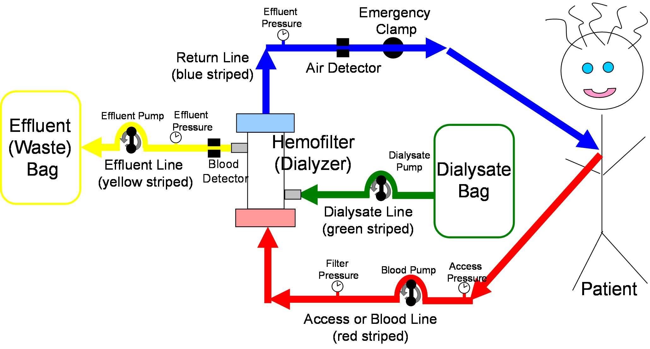

Slide 4
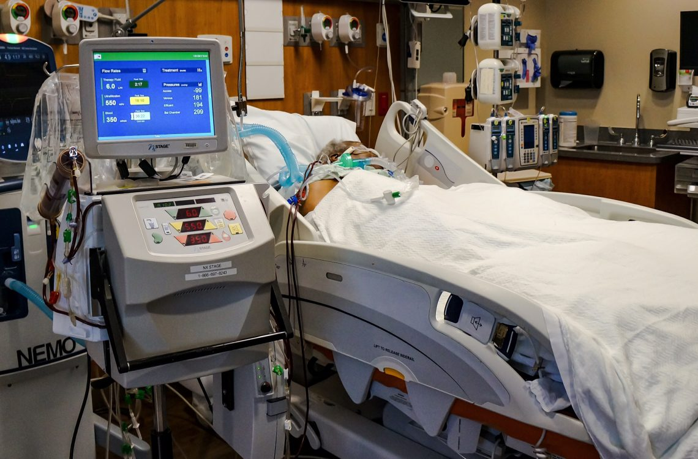

Slide 5
Medical Information Mart for Intensive Care (MIMIC-III)
MIMIC-III is an ICU database with ~50,000 ICU stays from BIDMC
Open access data base created by the MIT Laboratory for Computational Physiology
Deidentified data that can be used for descriptive, predictive, and causal inference studies
Generates ~3 papers/month

Slide 6
Cohort
Exclude patients <16 years of age
1,301 ICU stays
Test set was 20% of data
Remaining 80% further split into train/validation 90%/10%

Slide 7
Feature Extraction
Static: Direct pull from materialized views
Demographics
Baseline illness severity on day 1 (OASIS score)
Baseline comorbidity (Elixhauser score)
Vasopressors given?
Ventilation given?
Sequence: Custom built pipeline
Vitals: HR, RR, SBP, DBP, MAP, SpO2
Labs: CBC, comprehensive metabolic
Resampled to 1 hour for previous 24 hours

Slide 8
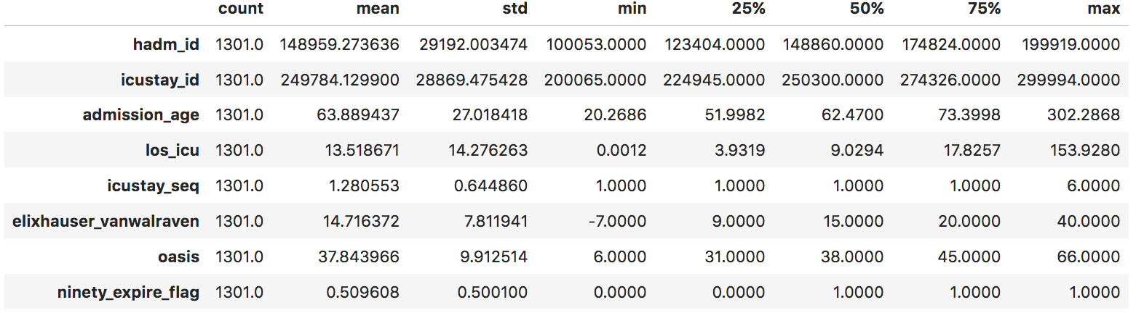
Descriptive Statistics for Static Features

Slide 9
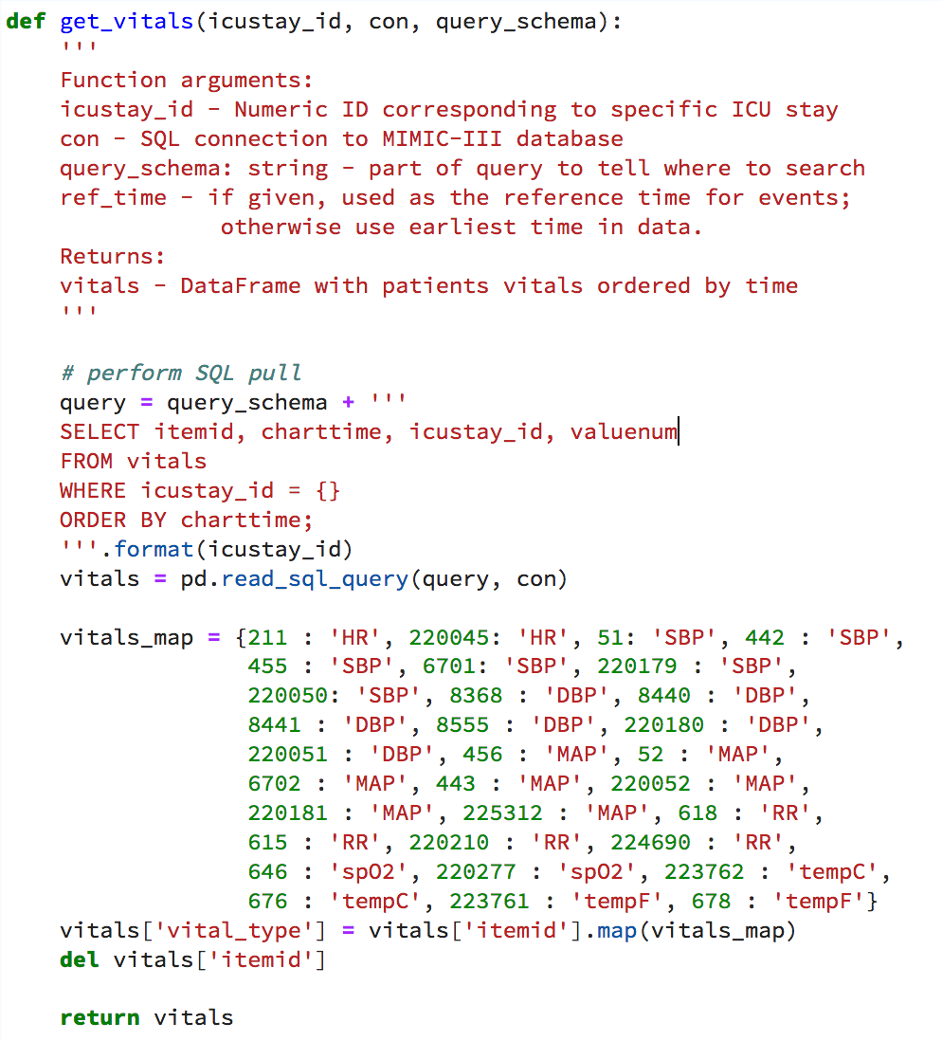
Feature Extraction

Slide 10
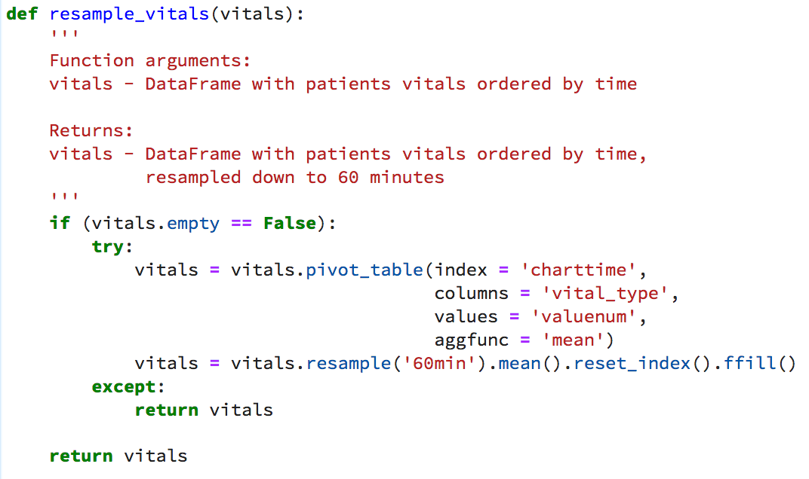
Feature Extraction

Slide 11
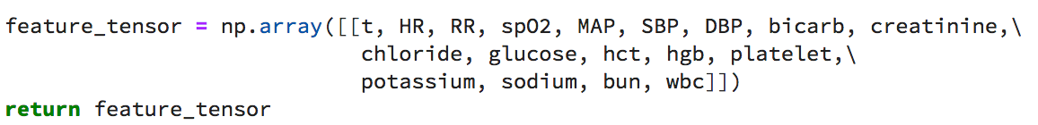
Feature Extraction

Slide 12
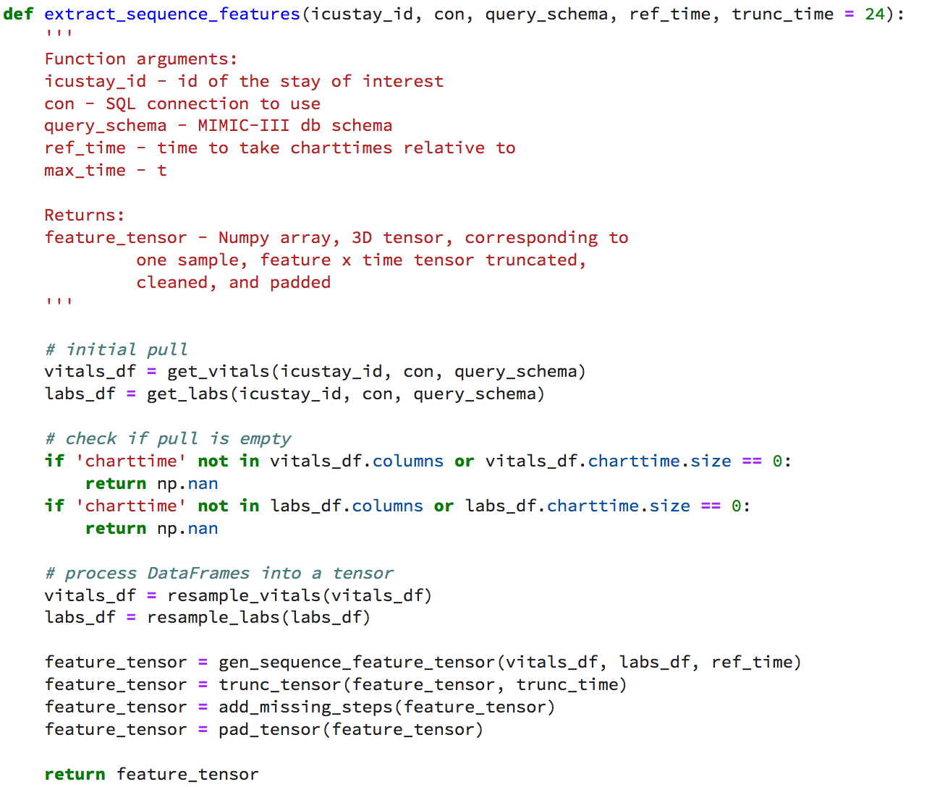
Features

Slide 13
Model Architecture & Optimization
Dataset was split into training and validation sets
Trained a general recurrent unit (GRU) and recurrent neural network (RNN)
Experimented with dropout
Both set to 10%
Two data types
Static: from beginning of stay in ICU
Sequential: from last day in ICU
Time-series data was input to the GRU
Local loss function - trained smoothly instead of relying on total loss of full model
automated feature extraction
Both data were merged and fed into a densely connected feedforward network.
Optimizer: rmsprop, LR: 0.00001

Slide 14
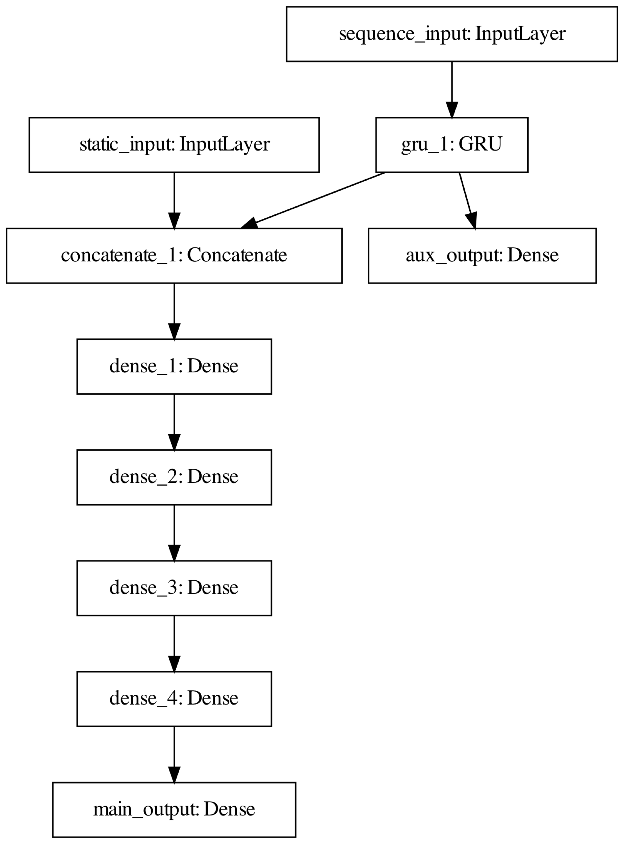

Slide 15
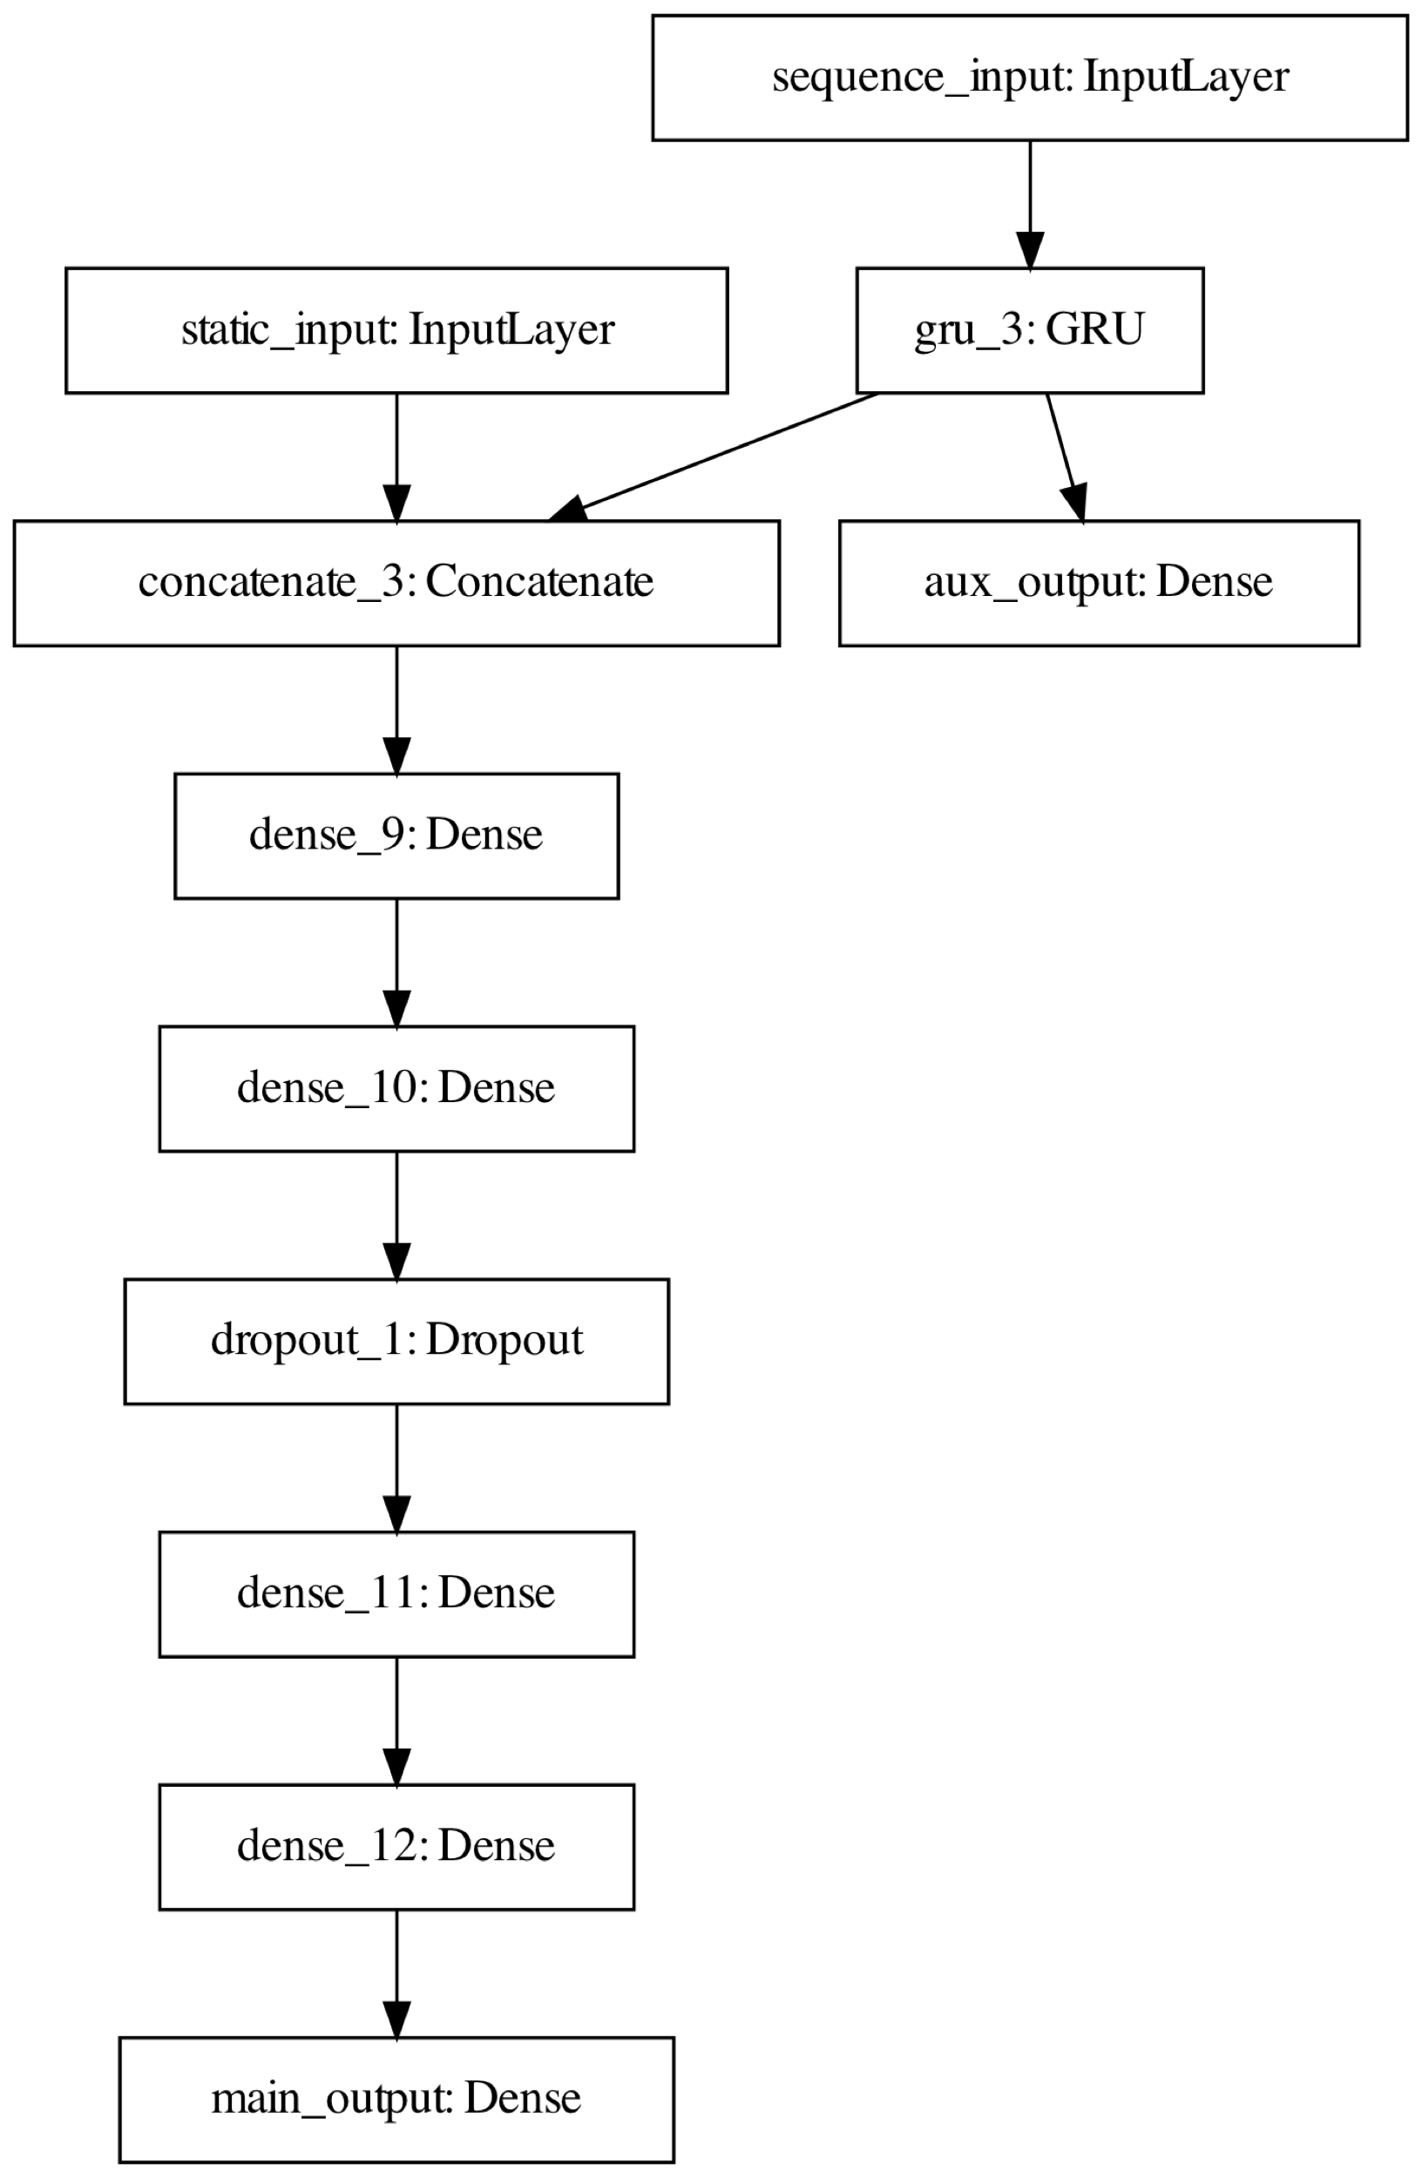

Slide 16
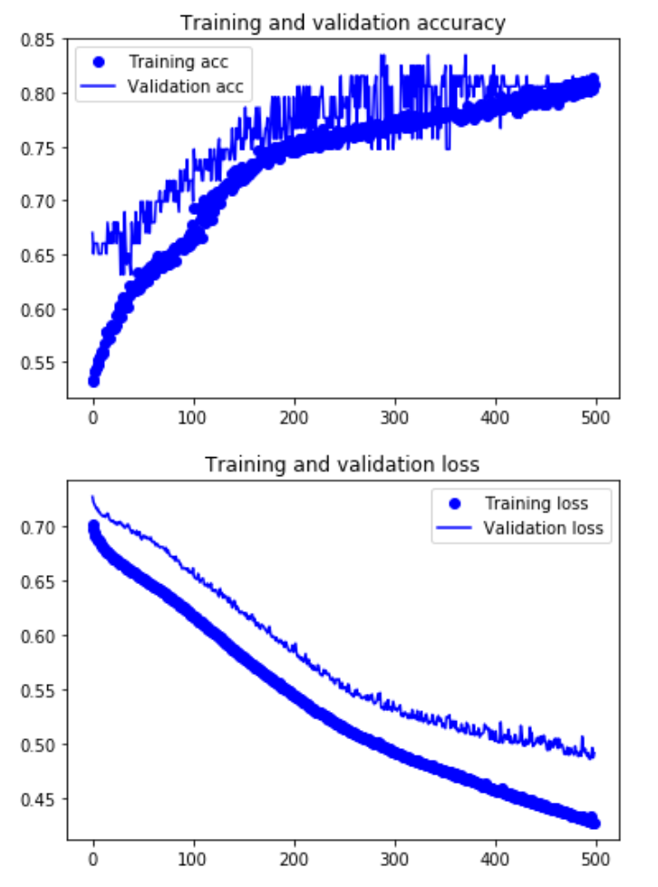
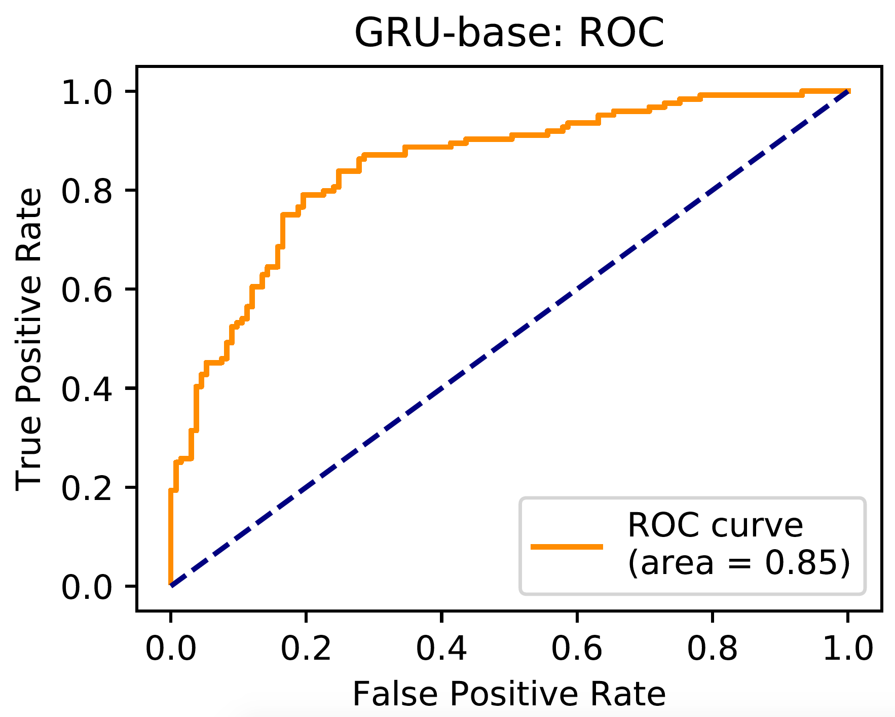
Base Model Results
AUC: 0.85

Slide 17
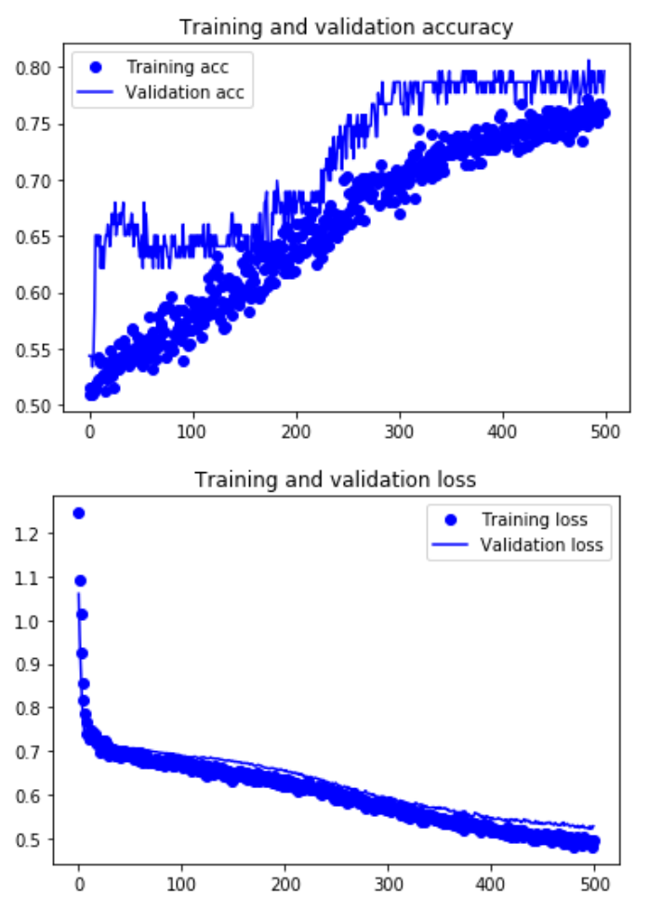
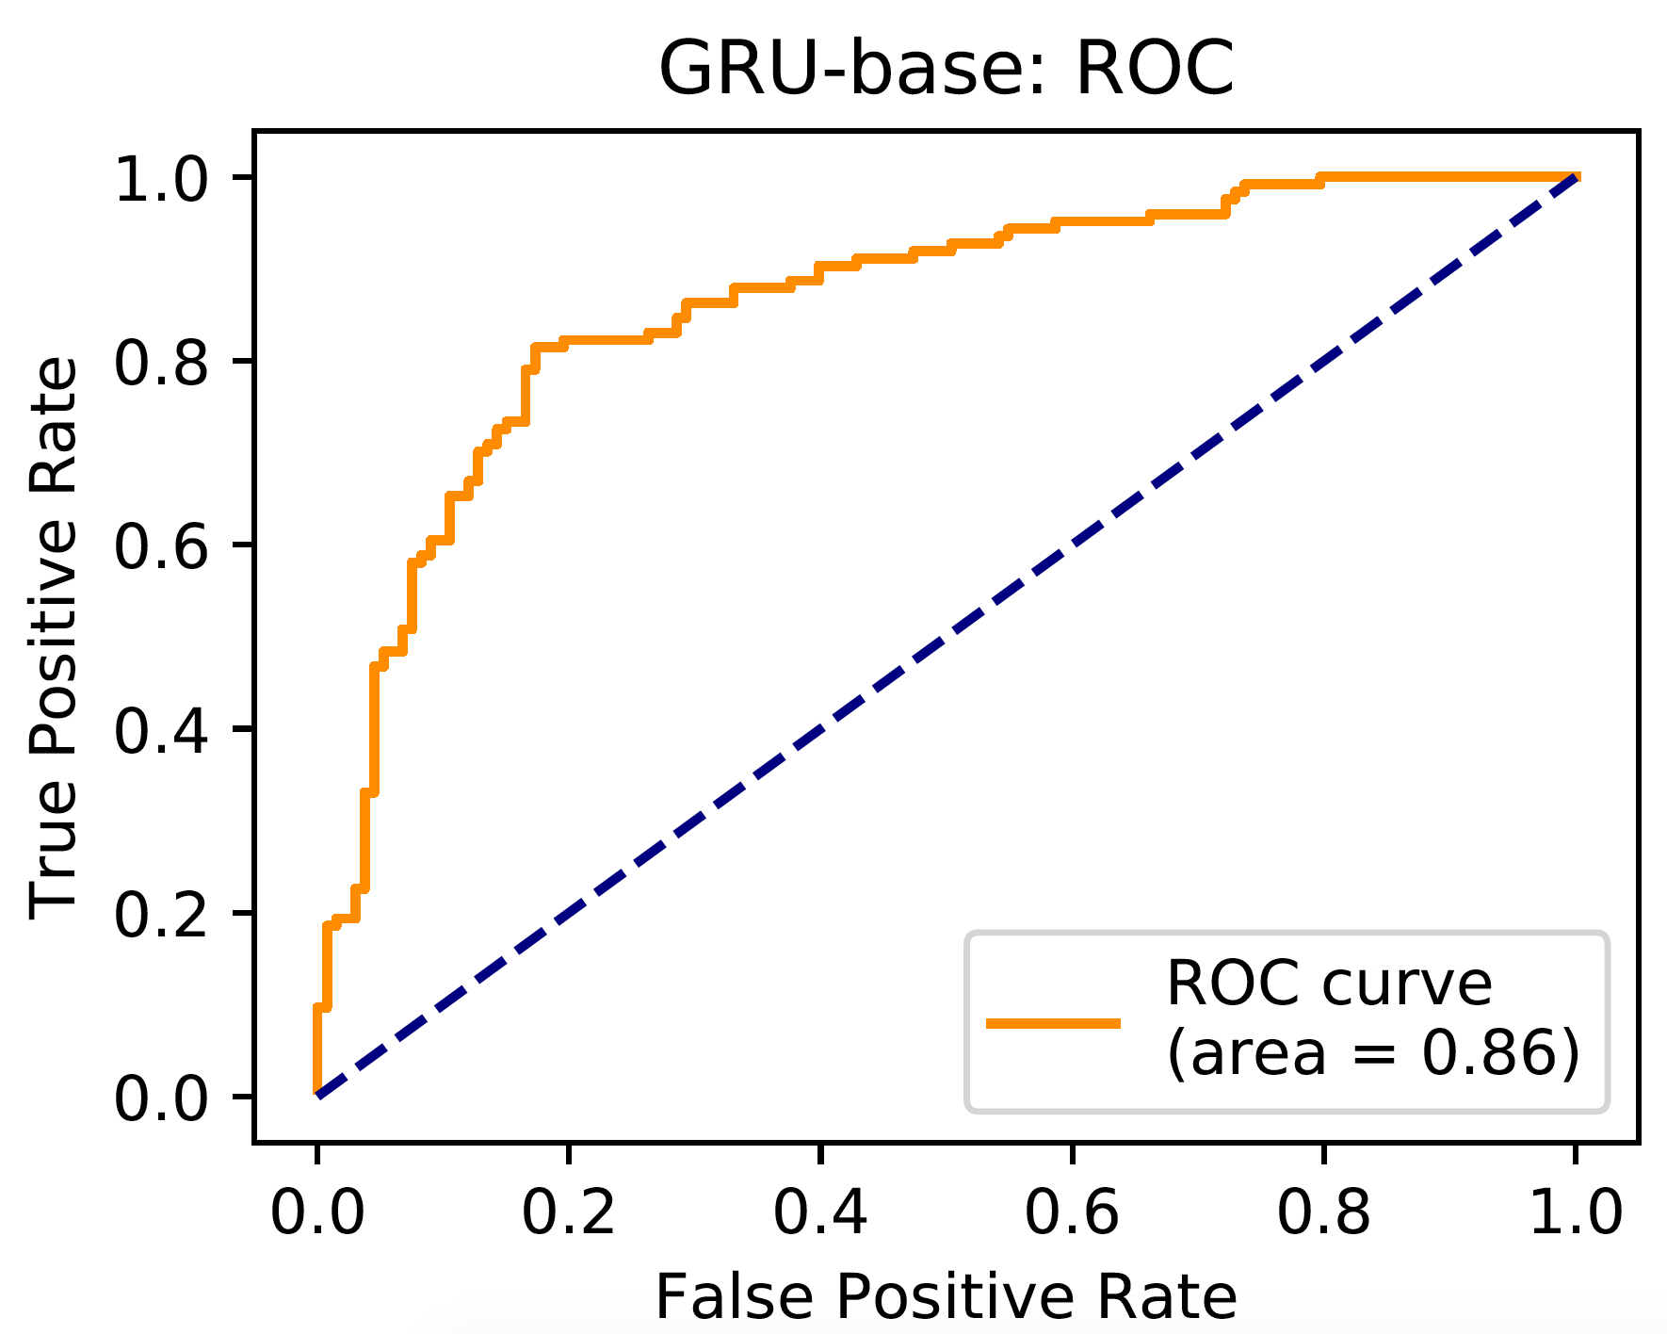
Dropout Model
AUC: 0.86

Slide 18
Conclusion
We successful built classifiers with good discriminatory capability
We were limited by time and would like to train these models with more complex architecture
Plan to carry project forward and explore other data sources

